Slide 1

Jupyter in the modern enterprise analytical ecosystem
  Trends, experiments and opportunities
    Gerald Rousselle, Director Product Management – Analytical Ecosystem
      8/24/2018

Slide 2

We believe…
Analytics and data unleash the potential of great companies

Slide 3
What we do…
We empower companies to achieve
high-impact business outcomes through
analytics at scale on an agile data foundation

Slide 4


About me
Director Product Management, Analytical Ecosystem at Teradata:
  Next Generation Deployment and Access capabilities
  AIOps
  Core Ecosystem micro-services/APIs
  Data Science and Developer experiences
Analytics as a Service startup
for mobile games

Slide 5

Agenda
      The Modern Enterprise Data and Analytics Ecosystem
      Jupyter in the enterprise
      Extending Jupyter beyond Data Science
      Demos
      Key takeaways

Slide 6
My key takeaway from JupyterCON 2017
Come for the notebooks
Stay for the open source protocols
& the community

Slide 7
The modern Enterprise Analytical Ecosystem

Slide 8
Our Enterprise customers
Run millions to tens of millions of queries a day over petabytes of data
Have thousands to tens of thousands of business users accessing their Business Intelligence tools
Have hundreds of business analysts to drive their in analytics
Have tens to hundreds of data scientists working on advanced analytics
Have centralized IT teams and PD teams to support data and analytics infrastructures and Service Level Agreements
Have presence across the world
Have acquired a few companies along the way
Use data and analytics at scale to drive business outcomes

Slide 9


The 2020 Analytical Ecosystem Will…
IDC Market Analysis Perspective: Business Analytics Software, 2016;
Gartner DMSA MQ, 2017; Teradata Cloud Survey, 2016; Customer feedback
Support solutions across data platforms/types
Allow customers to leverage hybrid clouds
Integrate with existing services & platforms
Embrace & leverage open source
Use instrumentation to drive decisions

Slide 10

The future of analytics
Descriptive Analytics
Prescriptive
Analytics
Predictive
Analytics

Slide 11
Unified Data Architecture
Sources
Acquisition
Data Engines
Analytics
Access
Users
REAL TIME
Audio
and Video
No SQL
MULTI GENRE
Marketing
Executives
DATA LAKE
APP FRAMEWORK
Sensors
Operational
Systems
VIRTUAL QUERY
OPERATIONAL
Text
INGEST
EMERGING
Customers
Partners
Web and
Social
IN MEMORY
DATA
WAREHOUSE
Business
Intelligence
Knowledge
Workers
Machine
Logs
COMPUTE CLUSTER
CONVENTIONAL
Languages
Business
Analysts
crm
Integrated
Development
Environment
scm
Data
Scientists
Platform Services
DATA
DEVELOPMENT
OPERATIONS
erp
Cloud Deployment
PUBLIC
PRIVATE
HYBRID
Engineers

Slide 12
Key Challenges
How to provide an unified access experience to manage the increasing complexity of the ecosystem?
How do you enable collaboration for faster time to value and better business outcomes?

Slide 13
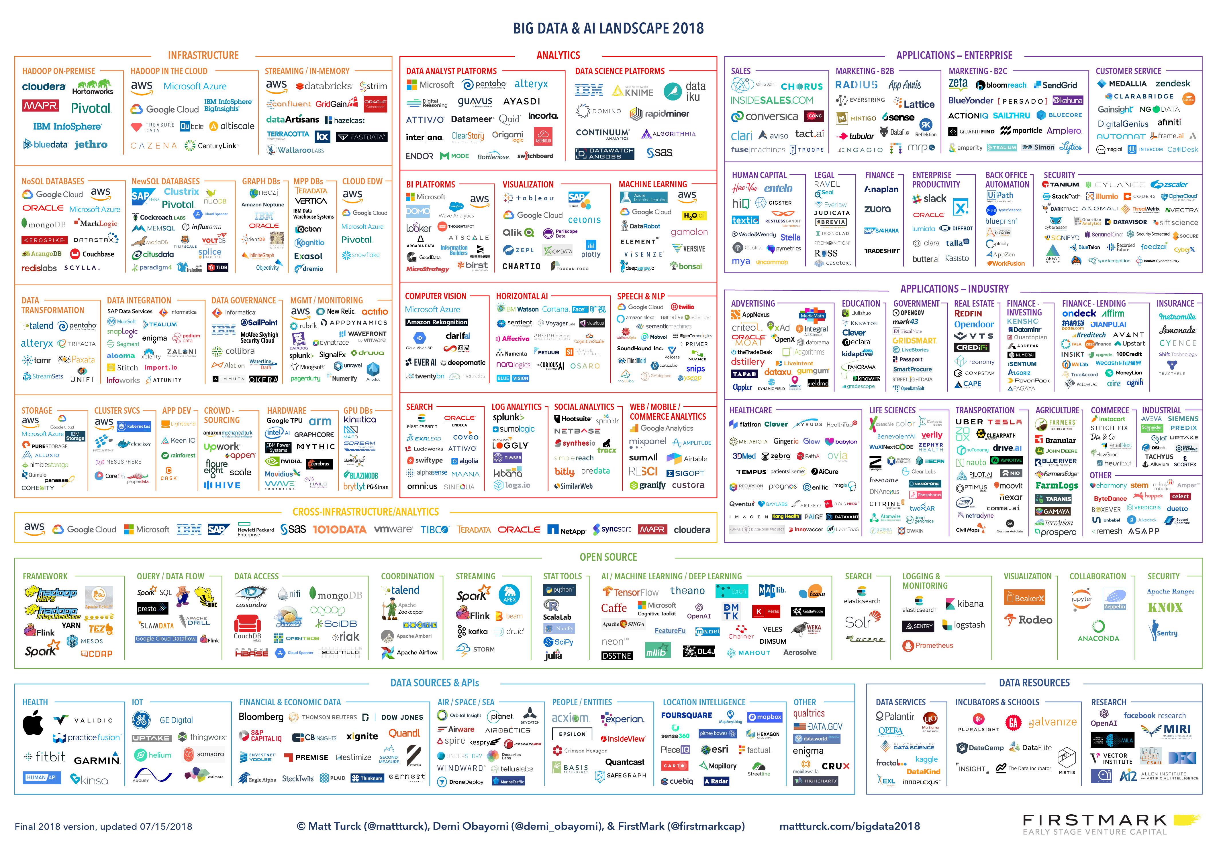
Complexity leads to a need for unified experiences

Slide 14

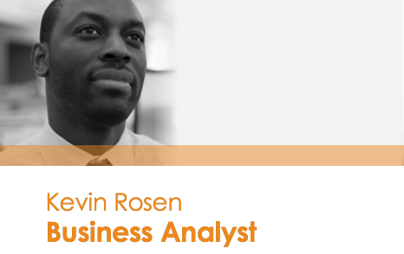
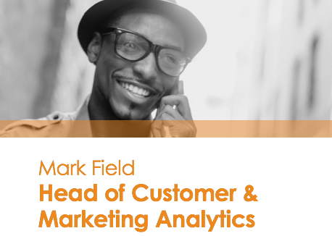

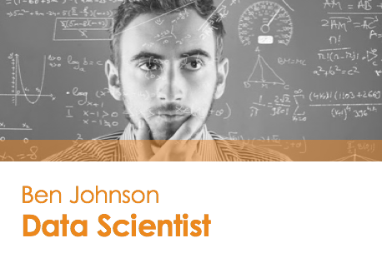



Collaboration

Slide 15
Collaboration
How do you facilitate sharing and reuse?
  Datasets
  Code
  Libraries
  Model
  Results
  Apps
How do you facilitate the process?
  Handshakes
  Integrated Workflow
  Full stack enablement
  Social features

Slide 16
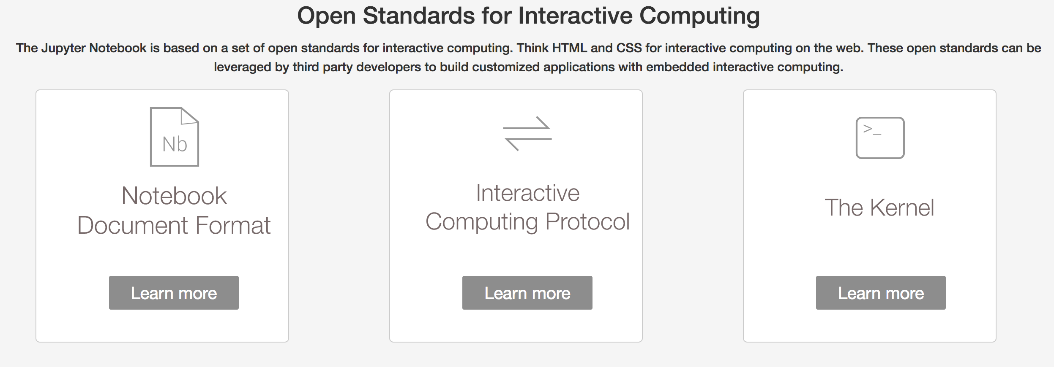
We see Jupyter as an emerging technology to solve those challenges
access
collaborate
Manage complexity

Slide 17
Jupyter in the Enterprise

Slide 18
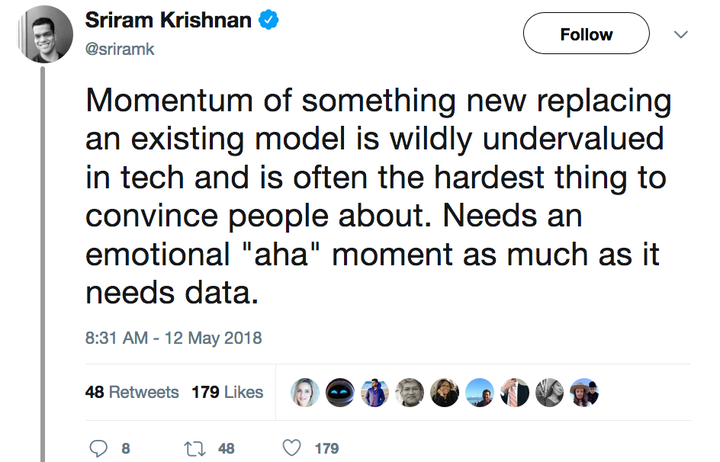
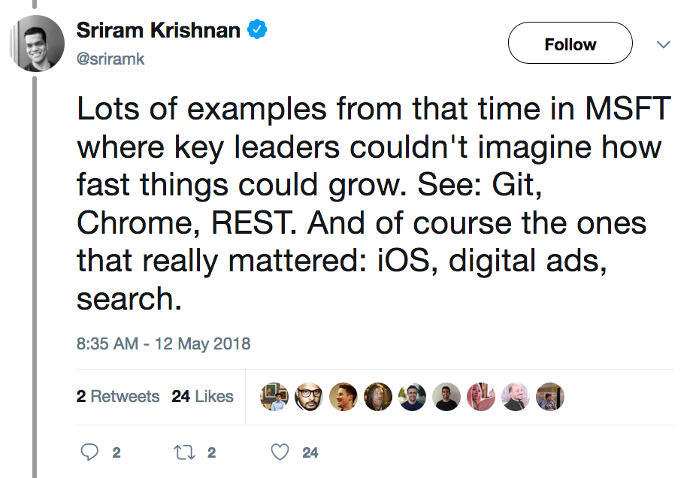
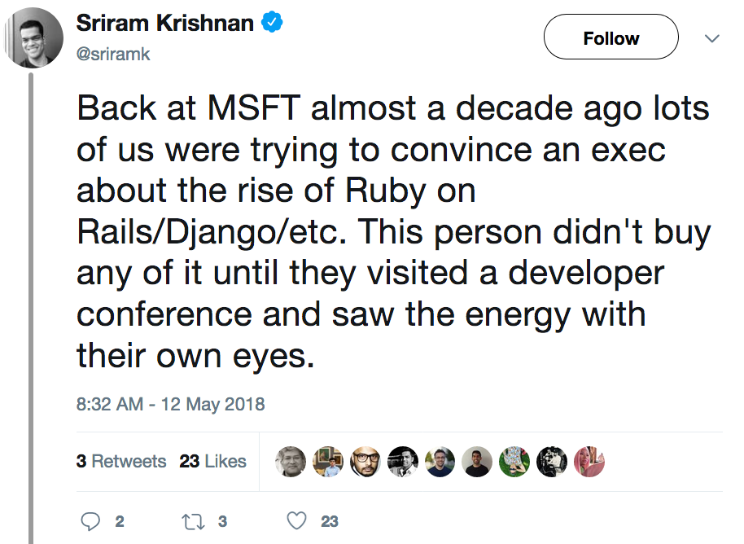
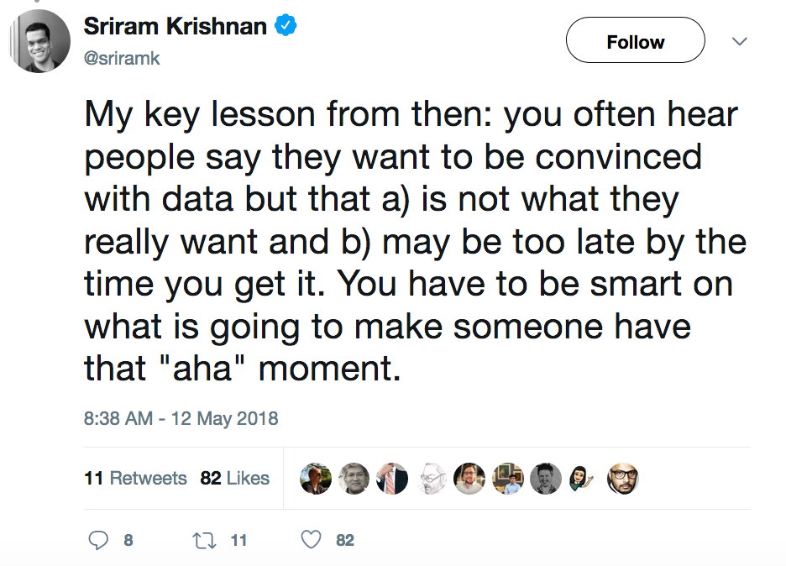
Evaluating technology momentum is hard

Slide 19
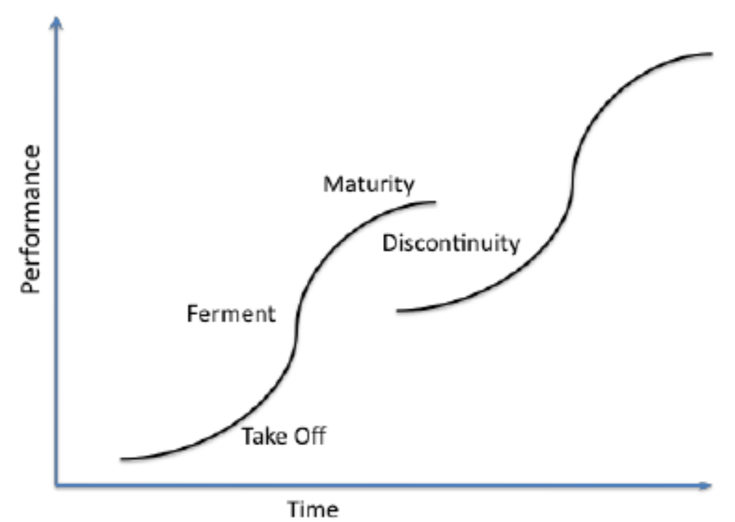
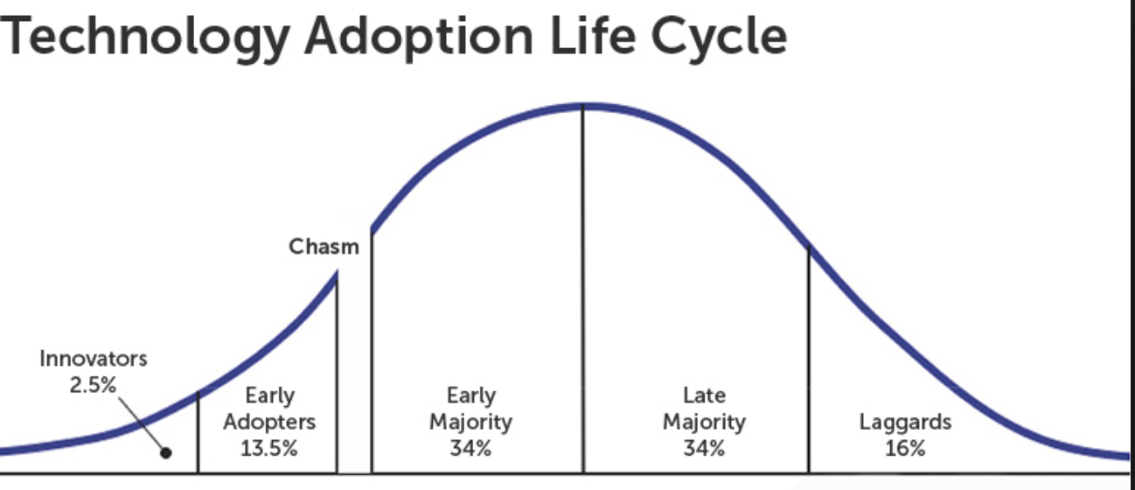
NOW about to cross the chasm / take off in the Enterprise

Slide 20



Announced at JupyterCON 2018
https://medium.com/netflix-techblog/notebook-innovation-591ee3221233
https://gimel.io
https://ppextensions.io

Slide 21


Bridging the Divide
“Access to the toolbox
of choice”
“Provide agility with control”
Data Scientist
Ben
CIO
Carole
Ben, the data scientist, wants the freedom to choose the best tools to create business outcomes through data
Carole, the CIO, wants to de-risk IT investments while operating at scale within SLAs

Slide 22







Key requirements for the enterprise
Analytics
Platform
End Users
Performance/scale
productivity
flexibility
IT
security
Predictable Service Level Agreements
Low Total Cost of Ownership
Support
Audit and Compliance

Slide 23




From client side to platform
Traditional Analytics
In-Platform Analytics
laptop
4
3
4
×
÷
1
+
−
1
2
4x
API
3
SQL
SQL
2
engine
36x
36x
36x
36x
×
÷
36x
36x
36x
36x
+
−
…
…
…
…

Slide 24
Extending Jupyter beyond Data Science

Slide 25

Data Science process workflow
Discover Data
Access Data
Prepare Data
Create, Find &Tune Models
Socialize Results
Deploy Model
Monitor Models

Slide 26
Analytics process workflow
Discover Data
Access Data
Prepare Data
Enrich Data
Analyze Data
Present Results

Slide 27
Languages and tool preferences
Languages
Python
R
SAS
Spark
SQL
VBA
Tools
Jupyter
R Studio
Query tool
Tableau
Excel

Slide 28




Extending Jupyter to Business Analysts
Interactive
Dashboard/
Analytics
Apps
API

Slide 29
Benefits to the business analyst
Easier to share end to end analysis
Easier to productionalize SQL work
Easier access to additional data sources (for example data lake)
Can leverage the work produced for Data scientist citizens

Slide 30
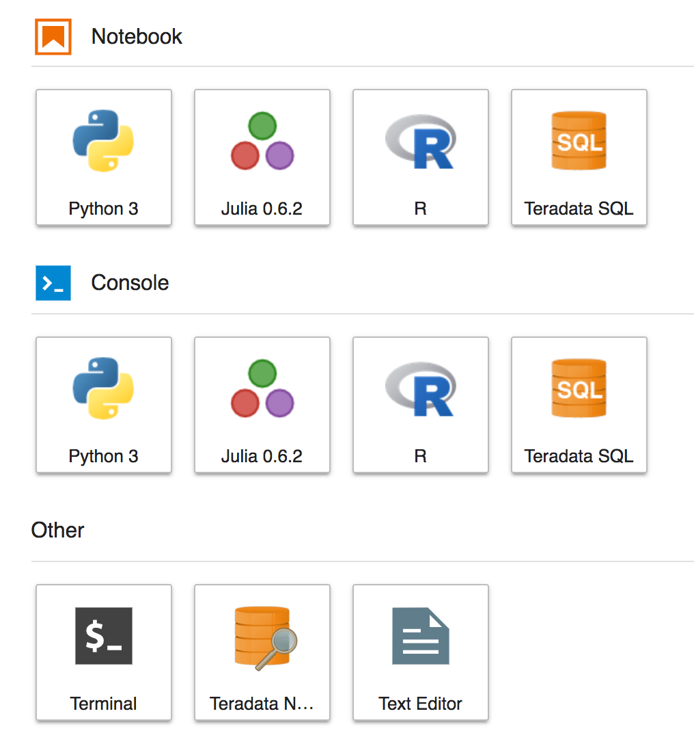
Introducing Teradata SQL Extension for Jupyter
c
c
c

Slide 31
Demos

Slide 32
Takeaways

Slide 33
Key Takeaways
Jupyter is going to be a key piece of the modern enterprise analytical ecosystem
As part of the democratization process and the need for unified experiences, Jupyter will be used beyond the original data science community
Jupyter is more than notebooks, it is a set of open source protocols for interactive computations

Slide 34

Thank You
Gerald Rousselle #jupyter
@grousselle #teradataanalyticsplatform

